Slide 1


ACCESSIBILITY FOR
Universidade Federal de Lavras
Departamento de Ciência da Computação
SMART HOMES
General vision and a wearable glove-based device
Mateus Carvalho Gonçalves
Undergraduate student in Computer Science
Professor Gasperim Ramalho

Slide 2
Summary
Human-Computer Interaction short introduction;
Definition;
Special needs;
Smart homes:
Definition;
Accessibility;
Glove-based device;
Questions.
ACCESSIBITY FOR SMART HOMES: General vision and a wearable glove-based device

Slide 3
Human-Computer Interaction
Sobre o curso
Introduction:
Human-Computer Interaction is the study of the interaction between humans and computers in many ways.
As a field of research, HCI is situated at the intersection of computer science, behavioral sciences, design, media studies, and several other fields of study.
ACCESSIBITY FOR SMART HOMES: General vision and a wearable glove-based device

Slide 4
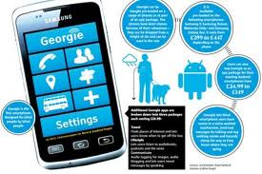
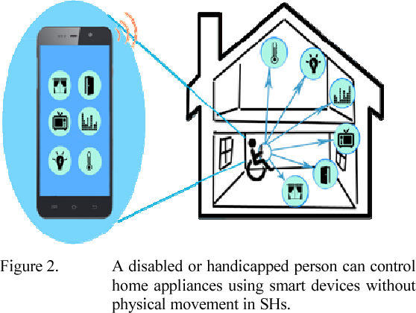
Human-Computer Interaction
Special needs
Some groups of people with some cognitive or physical limitation needs special tools to be attemted with new technologies.
ACCESSIBITY FOR SMART HOMES: General vision and a wearable glove-based device

Slide 5
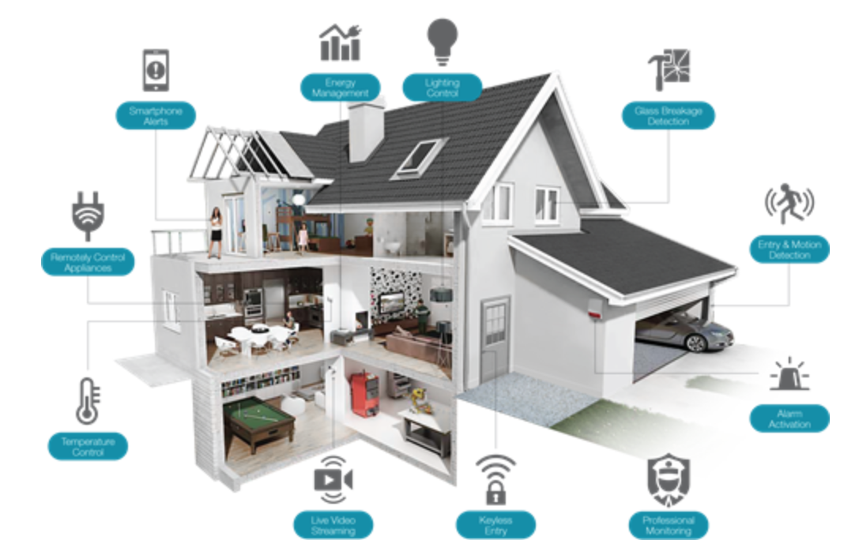
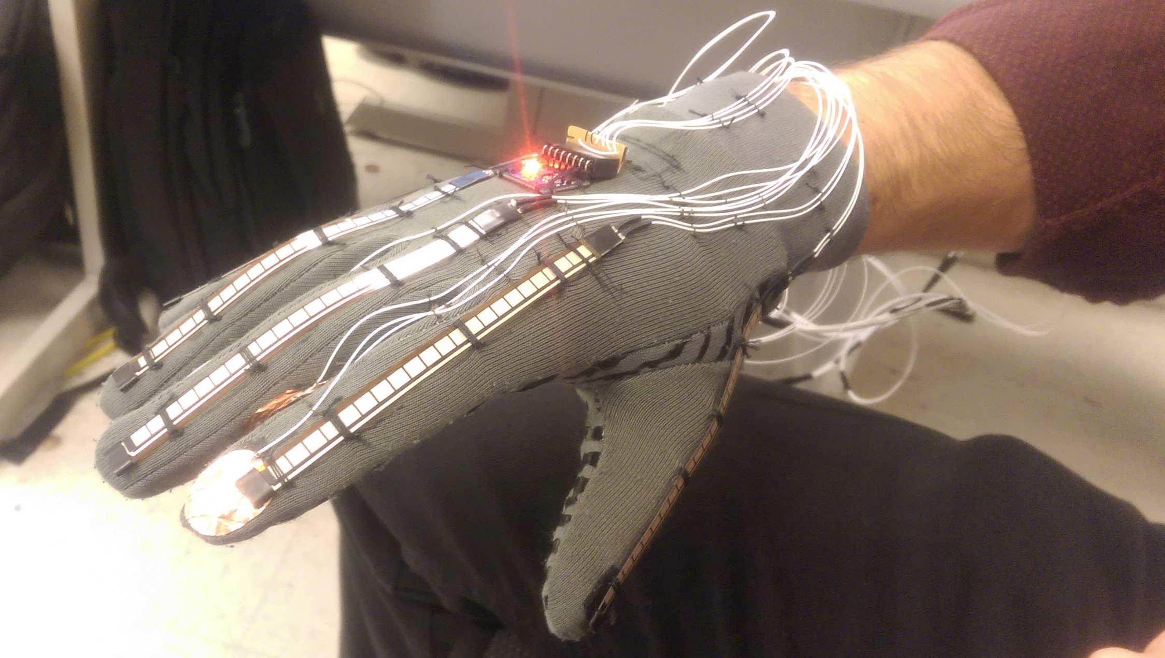
Smart Homes
Definition:
“A dwelling incorporating a communications network that connects the key electrical appliances and services, and allows them to be remotely controlled, monitored or accessed.”
- Intertek
ACCESSIBITY FOR SMART HOMES: General vision and a wearable glove-based device

Slide 6
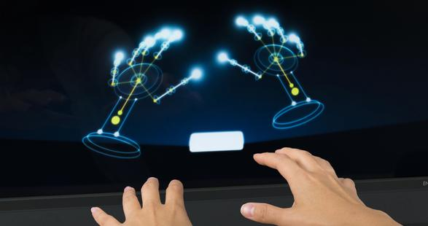
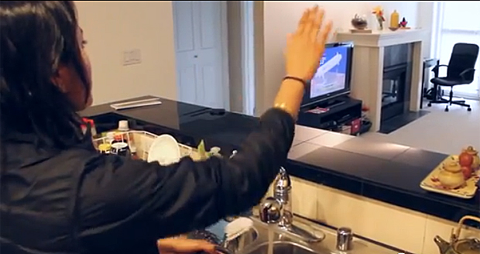
Smart Homes
Accessibility
Researches to solve the needs of disabled people for smart homes are increasing day to day.
ACCESSIBITY FOR SMART HOMES: General vision and a wearable glove-based device

Slide 7
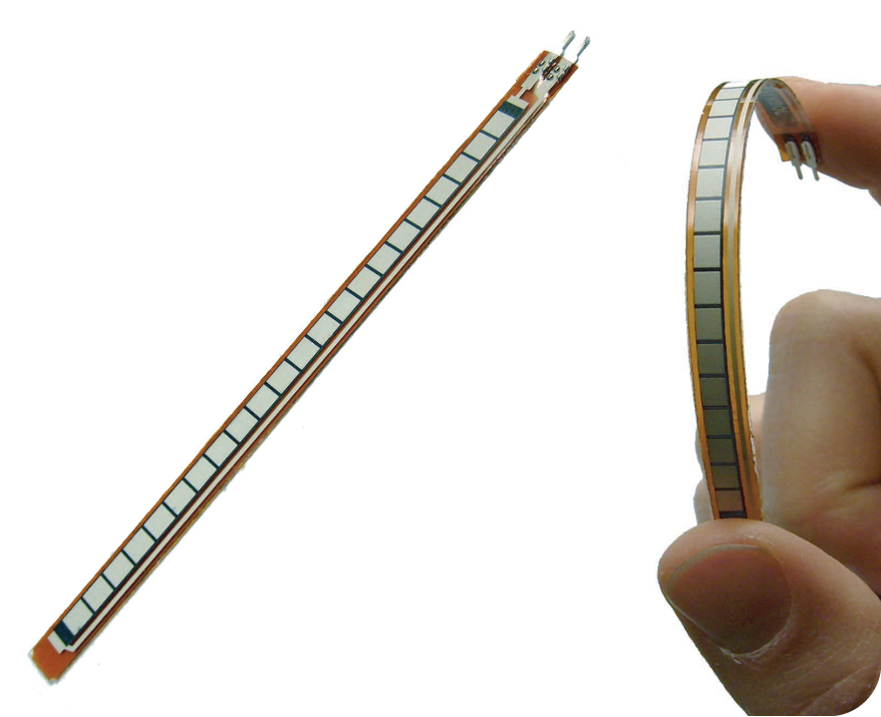
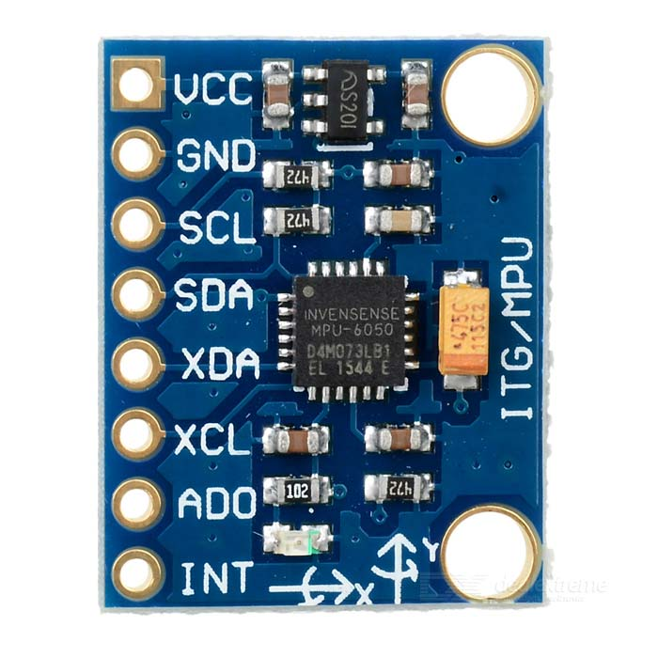
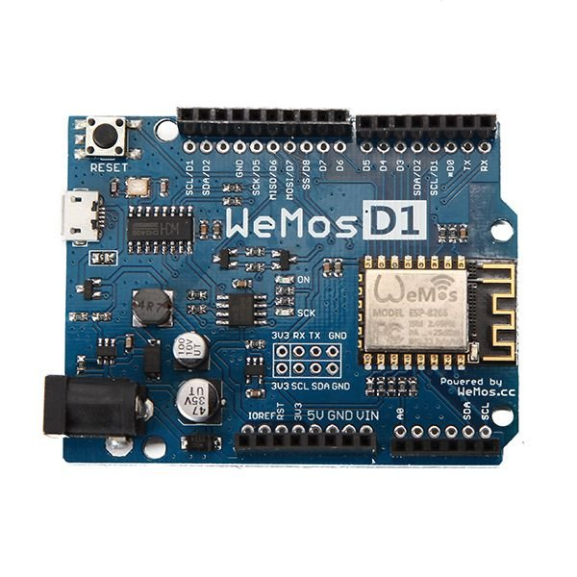
Smart Homes
Sobre o curso
Glove-based system
UFLA´s smart home project
Multimodal accessible system
IC personal project: weareble devide (glove-based)
2 Flexible sensors 2.2`` Sparkfun
1 Accelerometer GY-521
1 Microcontroller (Wemos)
ACCESSIBITY FOR SMART HOMES: General vision and a wearable glove-based device

Slide 8
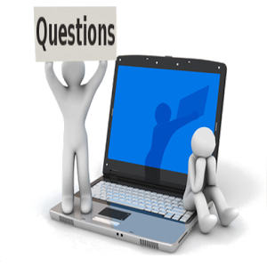
Gestão em Tecnologia da Informação (Tecnólogo)
Questions?
ACCESSIBITY FOR SMART HOMES: General vision and a wearable glove-based device

Slide 9

THANK YOU!
Universidade Federal de Lavras
Departamento de Ciência da Computação

